Slide 1

MACHINE LEARNING LAB PROJECT
On
HEALTHGUARD-Multi-Disease Diagnosis
BACHELOR OF TECHNOLOGY
IN
COMPUTER SCIENCE AND ENGINEERING
BY
BARIGALA JYOTHI SAIRAM -22VE1A0506
GARLAPATI SHRAVANI -22VE1A0512
KOWKUNTLA VARSHITH SAGAR-22VE1A0530
MADIREDDY INDU MAHITHA-22VE1A0533
ACADEMIC YEAR: 2024-25

Slide 2
Introduction
HealthGuard is a full-stack web application that helps users predict potential diseases by entering their symptoms. It includes secure signup and login functionality to ensure personalized access. The platform offers a clean and responsive user interface built with React.js, allowing users to input symptoms easily. The backend, developed with Node.js and Express.js, processes the data and interacts with a MongoDB database to fetch possible disease matches in real-time. HealthGuard aims to provide a quick and convenient health check experience from the comfort of a browser.

Slide 3
Project Overview
HealthGuard is a full-stack web application built using the MERN stack (MongoDB, Express.js, React.js, Node.js) that allows users to check whether they might have a specific disease based on the symptoms they enter. The application includes secure signup and login functionality to ensure personalized and safe access. After logging in, users can select relevant symptoms from a clean, responsive interface and submit them. The backend processes this input and determines whether the symptoms match those commonly associated with a specific disease, returning a yes/no result. HealthGuard provides users with a fast, accessible, and user-friendly tool to assess their health condition directly from their browser.

Slide 4
Tech Stack
Frontend – React.jsBuilt a responsive and interactive user interface where users can sign up, log in, and input their symptoms easily.
Backend – Node.js with Express.jsHandles the application logic, including symptom analysis and disease prediction, and manages API routes for user authentication and prediction processing.
Database – MongoDBUsed to securely store user authentication data such as login credentials and registration details.

Slide 5
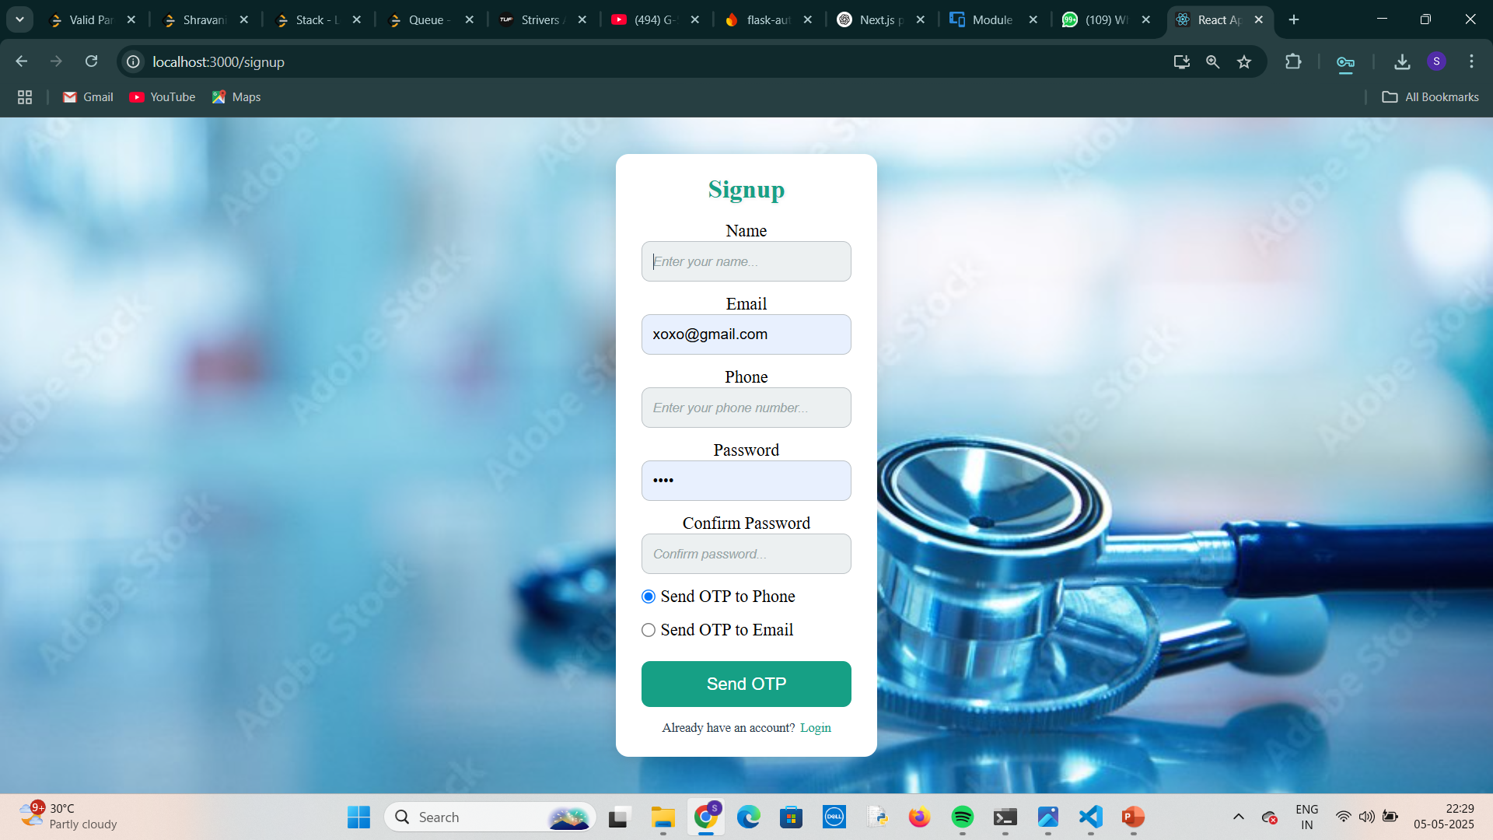
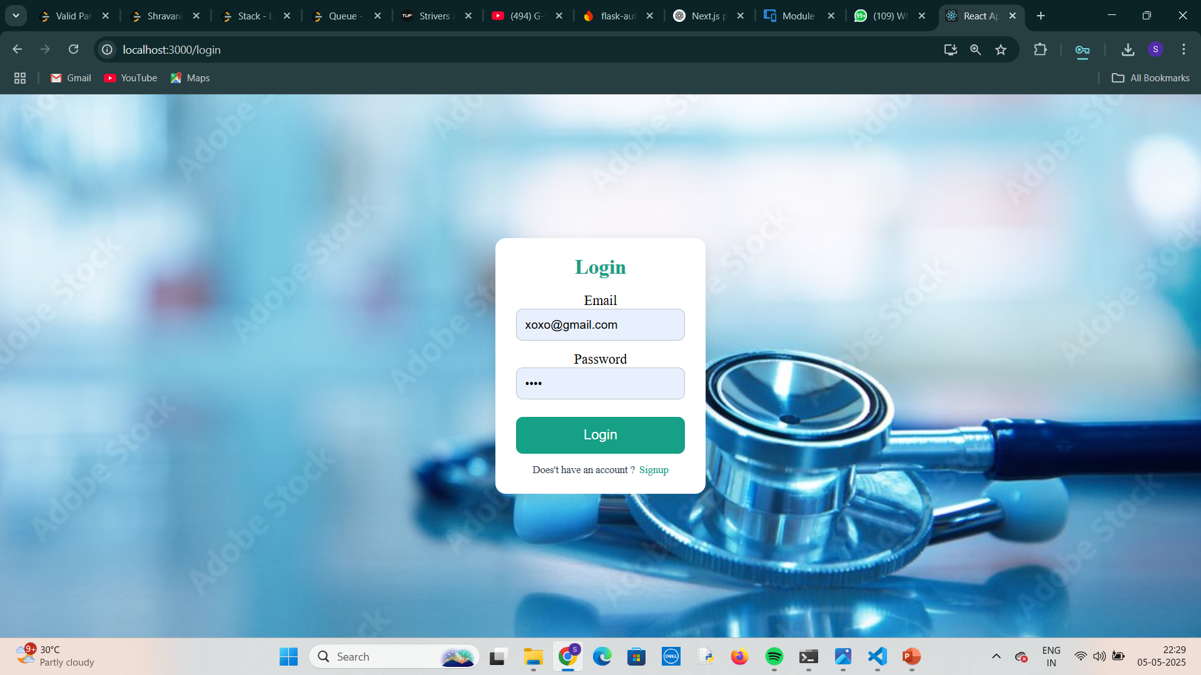
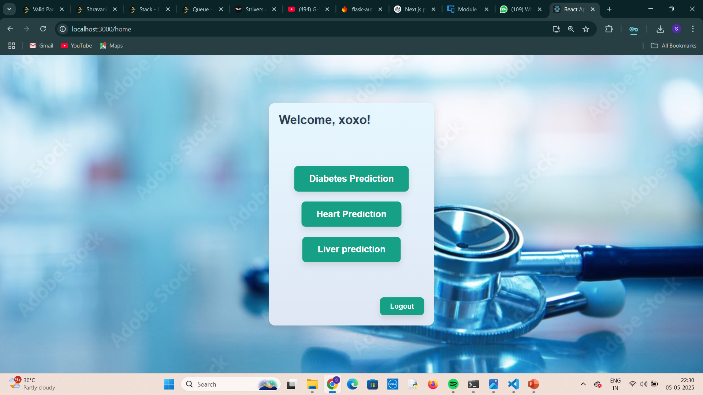
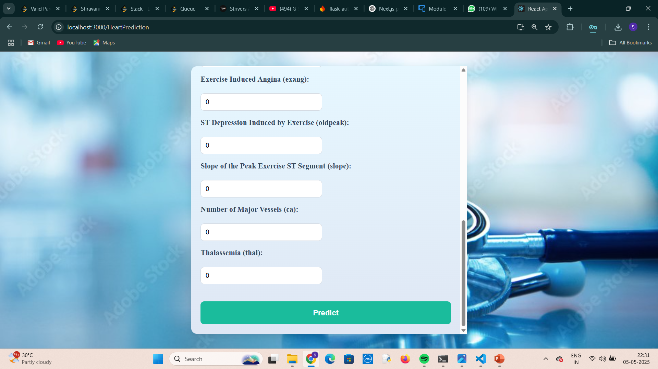
Frontend

Slide 6
Backend
// index.js
const express = require('express');
const cors = require('cors');
const AuthRouter = require('./Routes/AuthRouter');
const PredictionRouter = require('./Routes/PredictionRouter'); // Import the PredictionRouter
require('dotenv').config();
require('./Models/db'); // If you have any database connection, make sure it's initialized
const app = express();
const PORT = process.env.PORT || 3030;
app.get('/ping', (req, res) => {
res.send('PONG');
});
// Middleware
app.use(express.json()); // Directly use express.json() instead of body-parser
app.use(cors()); // CORS setup
// Routes
app.use('/auth', AuthRouter);
app.use('/predict', PredictionRouter); // Use PredictionRouter to handle /predict requests
// Start server
app.listen(PORT, () => {
console.log(`Server is running on port ${PORT}`);
});
The backend is built using Express.js, handling key endpoints for user authentication (/auth)
and disease prediction (/predict). It connects to MongoDB for securely storing user data and
provides a robust API for processing symptoms and returning real-time disease predictions.

Slide 7
DataBase
HealthGuard uses MongoDB as the database to securely store user authentication data, such as login credentials and session information. MongoDB’s flexible, document-based structure allows easy scaling and fast queries, ensuring that user data is efficiently managed. With MongoDB, HealthGuard can handle a large number of user accounts while ensuring data security and privacy.

Slide 8
Conclusion
HealthGuard is a powerful, full-stack web application that integrates user authentication and disease prediction based on symptom inputs. Through this project, we gained hands-on experience in building a secure and scalable application using the MERN stack (MongoDB, Express.js, React.js, Node.js). We also learned how to design an efficient backend, handle API requests, and manage user data securely. This project enhanced our skills in full-stack development, making us more proficient in handling real-world challenges and providing valuable solutions.

